Slide 1
A/B testing
A way to compare two versions of something to figure out which performs better

Slide 2
Application of A/B testing to Digital Marketing
Old web page
New web page
VS
Convert 13% of viewers to paying customers
Convert 15% of viewers to paying customers
15%-13%=2%???

Slide 3
A/B testing steps
Designing our experiment
Collecting and preparing the data
Visualizing the results
Testing the hypothesis
Drawing conclusions

Slide 4
A/B testing steps
Designing our experiment
  Formulating a hypothesis
  Choosing the variables
  Choosing a sample size

Slide 5

A/B testing steps
Designing our experiment
  Formulating a hypothesis
  Choosing the variables
  Choosing a sample size
Two Tailed Test
confidence level of 95%
𝛼=0.05
15%-13%=2%???

Slide 6
A/B testing steps
Designing our experiment
  Formulating a hypothesis
  Choosing the variables
  Choosing a sample size
Independent Variable(Group, assigned randomly)
Dependent Variable(converted)
A control group - They'll be shown the old design
A treatment (or experimental) group - They'll be shown the new design
0 - The user did not buy the product during this user session
1 - The user bought the product during this user session
Is there a relationship between Independent Variable and Dependent Variable?

Slide 7
A/B testing steps
Designing our experiment
  Formulating a hypothesis
  Choosing the variables
  Choosing a sample size
It is important to note that since we won't test the whole user base (our population), the conversion rates that we'll get will inevitably be only estimates of the true rates.
the larger the sample size, the more precise our estimates ,the higher the chance to detect a difference in the two groups, if present.
So how many people should we have in each group?
Power analysis:
Power of the test ( 1−𝛽 ) - This represents the probability of finding a statistical difference between the groups in our test when a difference is actually present. This is usually set at 0.8 as a convention
Alpha value ( 𝛼 ) - The critical value we set earlier to 0.05
Effect size - How big of a difference we expect there to be between the conversion rates: 15%-13%=2%

Slide 8
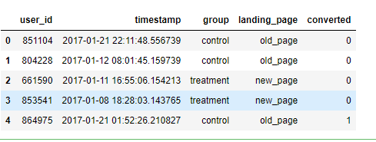
A/B testing steps
Designing our experiment
Collecting and preparing the data
Visualizing the results
Testing the hypothesis
Drawing conclusions
Make sure we have enough samples for each group

Slide 9
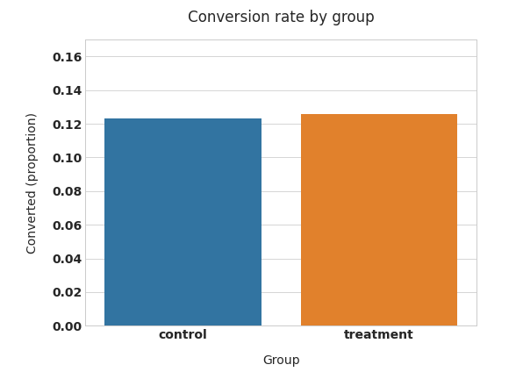
A/B testing steps
Designing our experiment
Collecting and preparing the data
Visualizing the results
Testing the hypothesis
Drawing conclusions

Slide 10
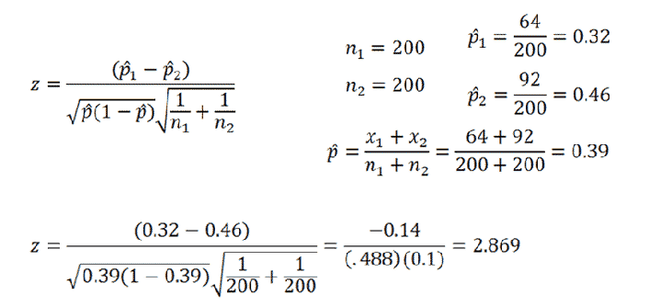
A/B testing steps
Designing our experiment
Collecting and preparing the data
Visualizing the results
Testing the hypothesis
Drawing conclusions
Test Result(using z-Test for Proportions, Two Samples)
z statistic: -0.34
p-value: 0.732
ci 95% for control group: [0.114, 0.133]
ci 95% for treatment group: [0.116, 0.135]

Slide 11
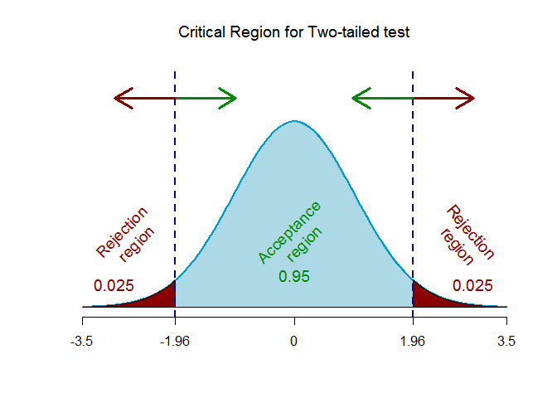
A/B testing steps
Designing our experiment
Collecting and preparing the data
Visualizing the results
Testing the hypothesis
Drawing conclusions
Test Result(using z-Test for Proportions, Two Samples)
z statistic: -0.34
p-value: 0.732
ci 95% for control group: [0.114, 0.133]
ci 95% for treatment group: [0.116, 0.135]

Slide 12
A/B testing steps
Designing our experiment
Collecting and preparing the data
Visualizing the results
Testing the hypothesis
Drawing conclusions
Test Result(using z-Test for Proportions, Two Samples)
A confidence interval (CI) is the mean of your estimate plus and minus the variation in that estimate. This is the range of values you expect your estimate to fall between if you redo your test, within a certain level of confidence. Confidence, in statistics, is another way to describe probability
z statistic: -0.34
p-value: 0.732
ci 95% for control group: [0.114, 0.133]
ci 95% for treatment group: [0.116, 0.135]

Slide 13
A/B testing steps
Designing our experiment
Collecting and preparing the data
Visualizing the results
Testing the hypothesis
Drawing conclusions
Since our 𝑝-value=0.732 is way above our 𝛼=0.05, we cannot reject the null hypothesis 𝐻0, which means that our new design did not perform significantly different (let alone better) than our old one
Additionally, if we look at the confidence interval for the treatment group ([0.116, 0.135], i.e. 11.6-13.5%) we notice that:It includes our baseline value of 13% conversion rate.It does not include our target value of 15% (the 2% uplift we were aiming for)
What this means is that it is more likely that the true conversion rate of the new design is similar to our baseline, rather than the 15% target we had hoped for. This is further proof that our new design is not likely to be an improvement on our old design, so the conclusion is that the new web page didn’t make a difference.

